Slide 1
Plot ideas for chapter 1
TD-Neutral = top-down without environmental degradation
TD-Env = top-down with environmental degradation
BU-Neutral = bottom-up without environmental degradation
BU-Env = bottom-up with environmental degradation
10 sims, 1% env deg applied to the community K per year (when applicable), 0 fishing on anyone

Slide 2
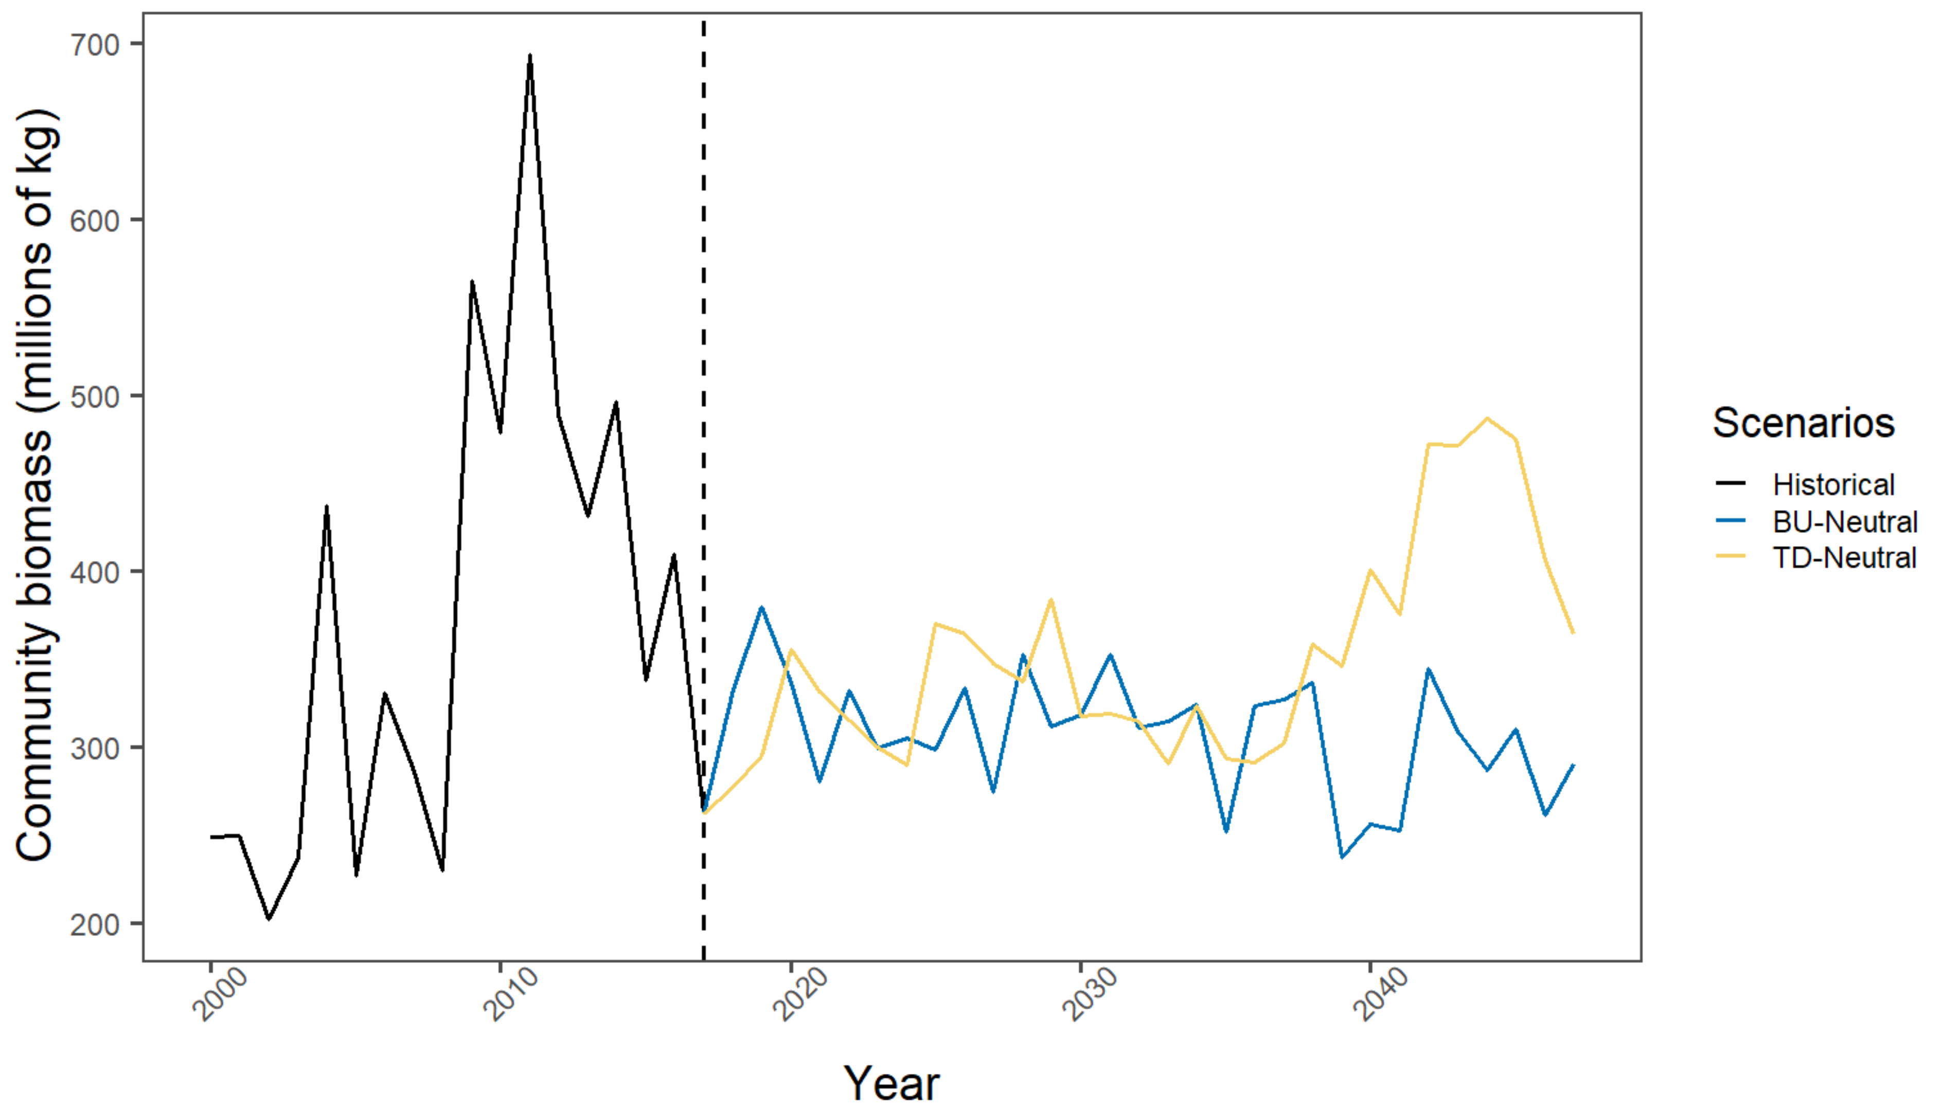
Notes:
Goal: show that model can recreate historical conditions. Historical time series + median simulation values for BU and TD. Ask DK for colour suggestions.
Would have one of these comparisons for community, FG and stocks

Slide 3
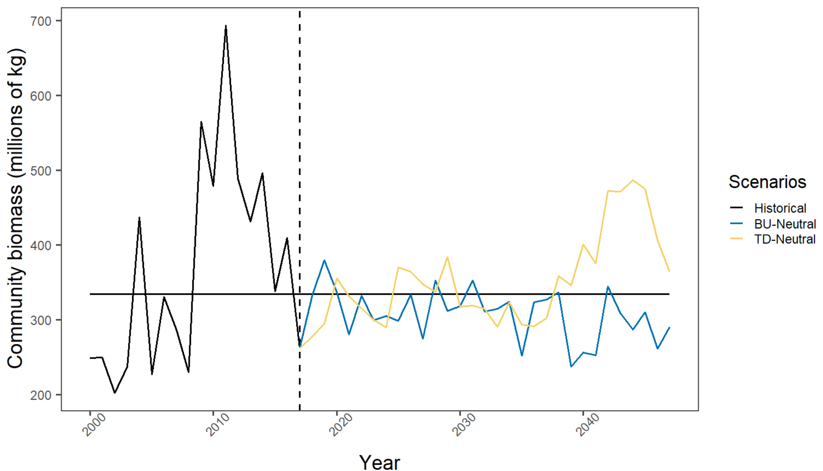
Notes:
Goal: show that model can recreate historical conditions. Same plot as previous slide, but with median historical biomass (horizontal black line) across all years.
Would have one of these comparisons for community, FG and stocks

Slide 4
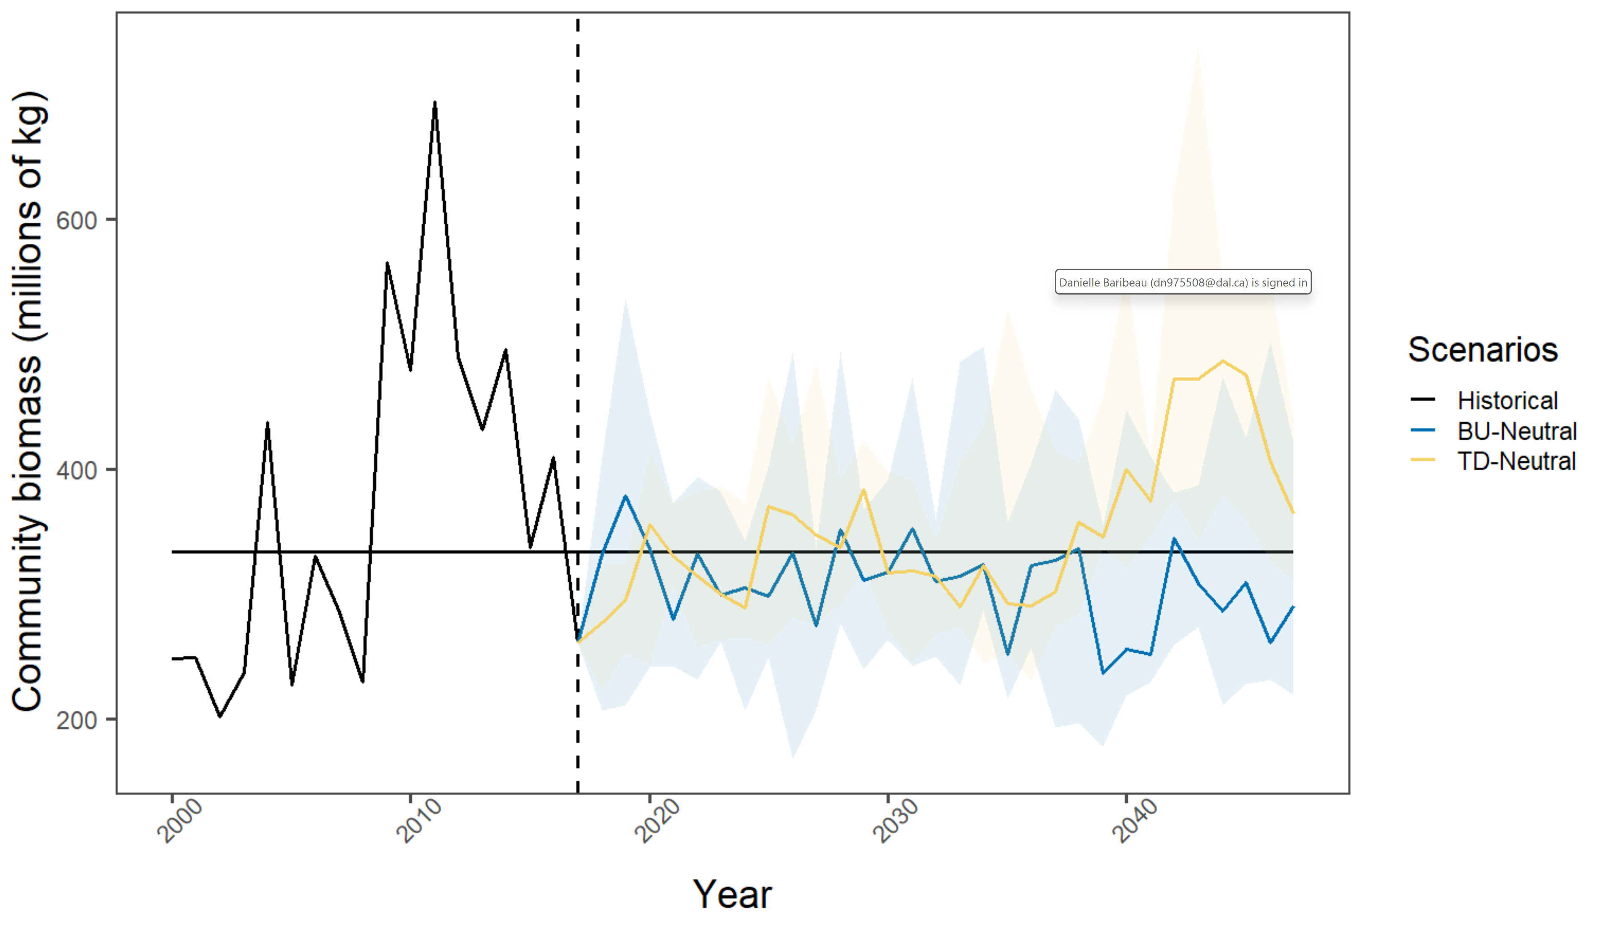
Notes:
Goal: show that model can recreate historical conditions. Same plot as previous slide, but with CIs (1st and 3 quantiles)
Would have one of these comparisons for community, FG and stocks

Slide 5
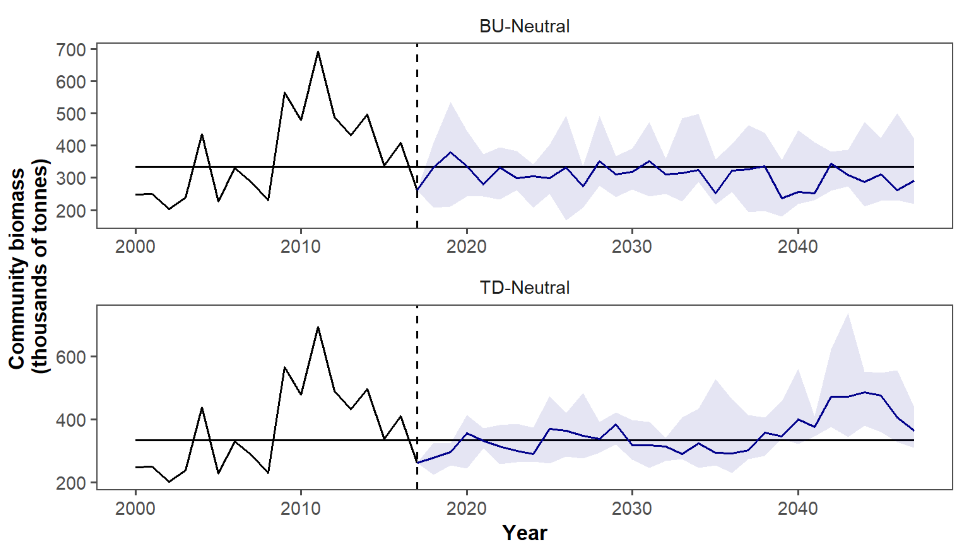
Notes:
Goal: show that model can recreate historical conditions. Same data, just arranged differently
Would have one of these comparisons for community, FG and stocks

Slide 6
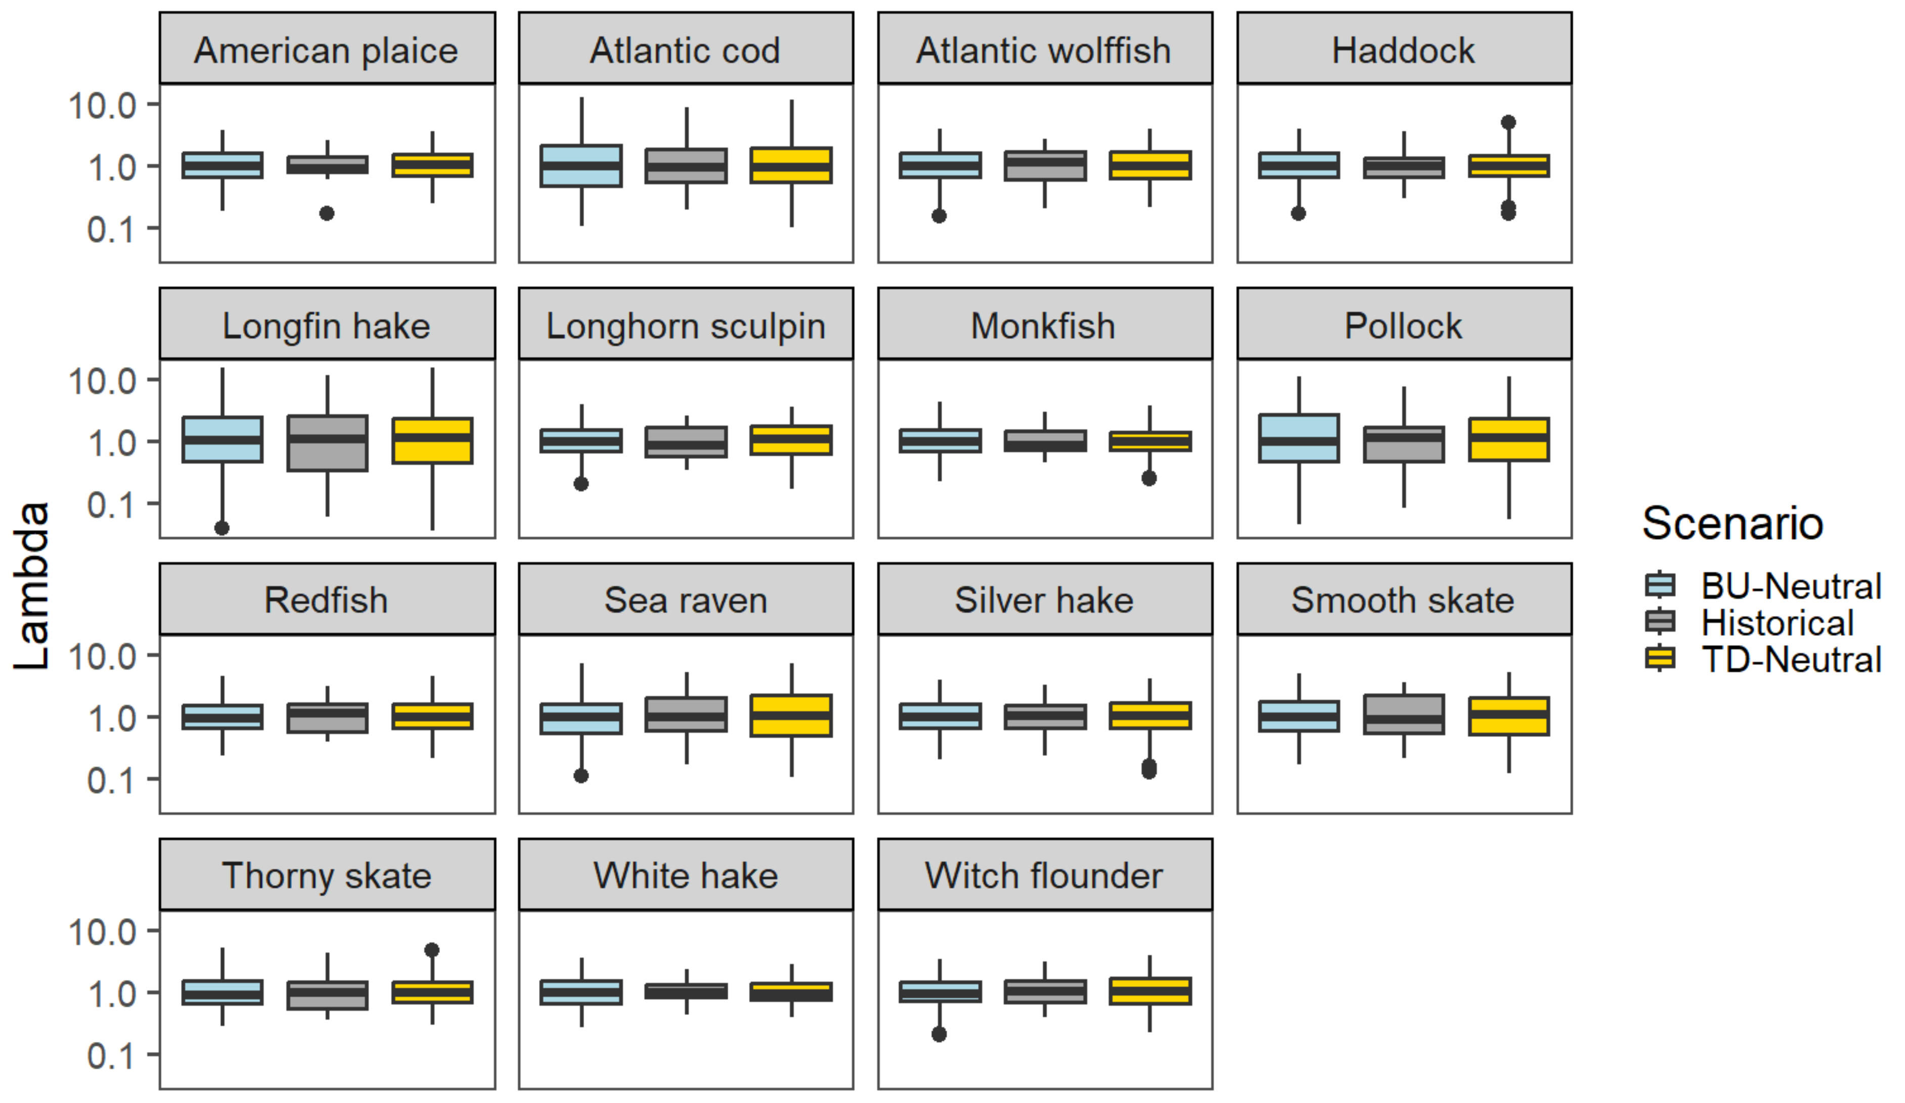
Notes:
Comparing distribution of historical and simulated lambdas for each stock. Y-axis is log scale

Slide 7
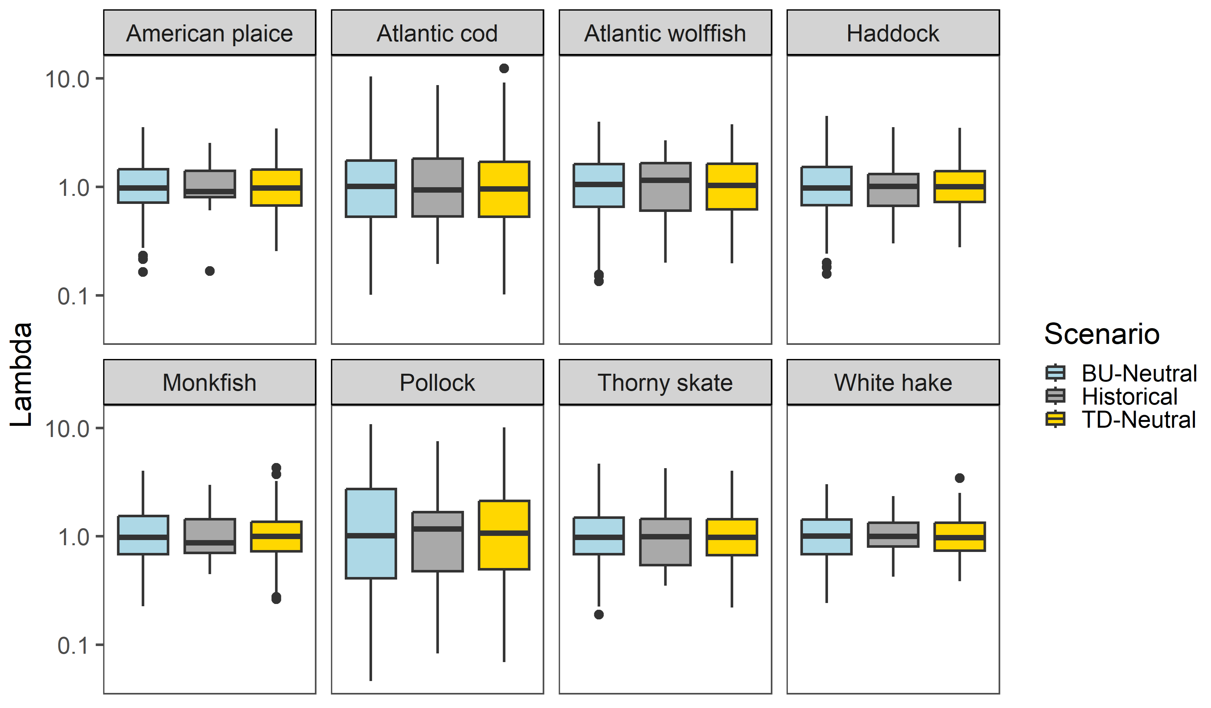
Notes:
Could also show functional groups in two separate figures to make differences in lambda more visible

Slide 8
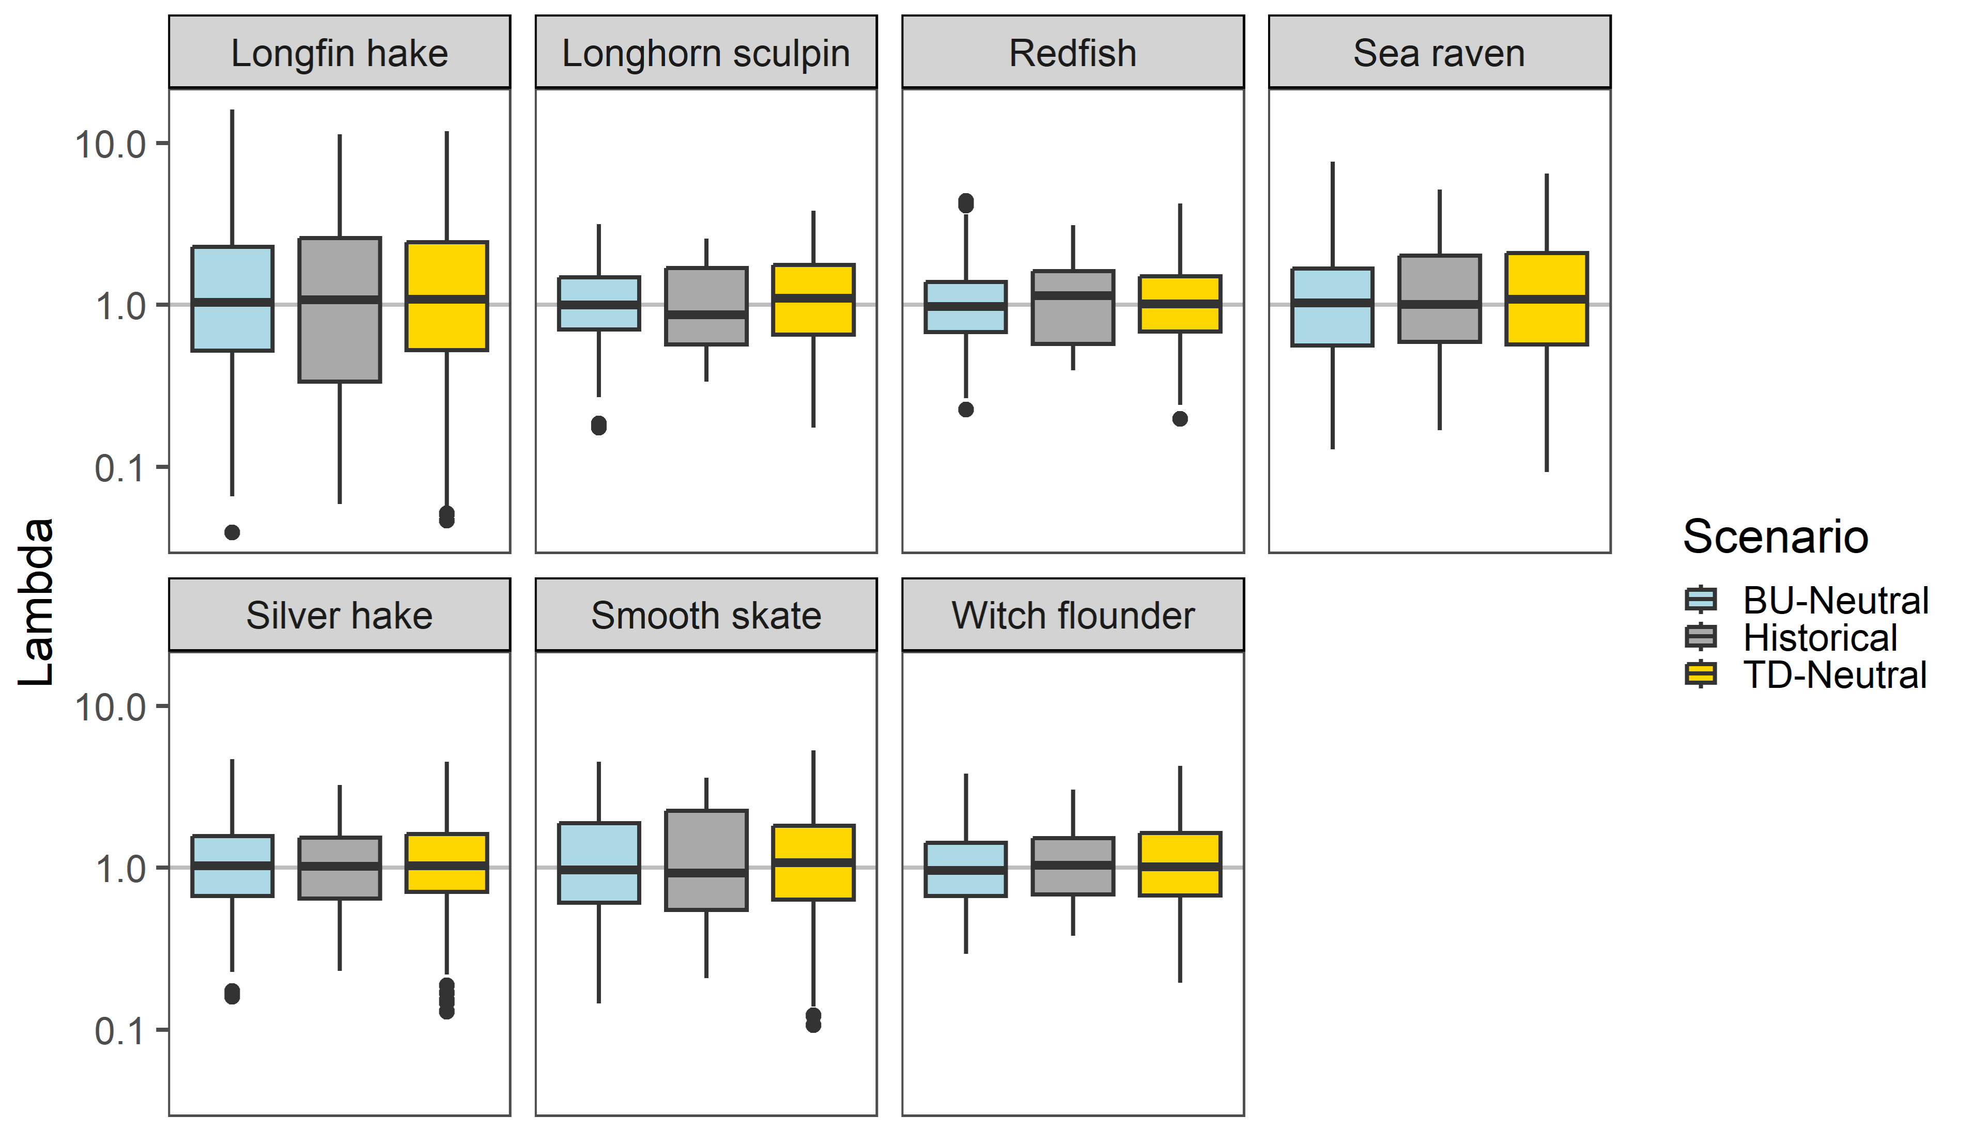
Notes:
Could also show functional groups in two separate figures to make differences in lambda more visible – same idea but with grey line at 1 for ref point

Slide 9
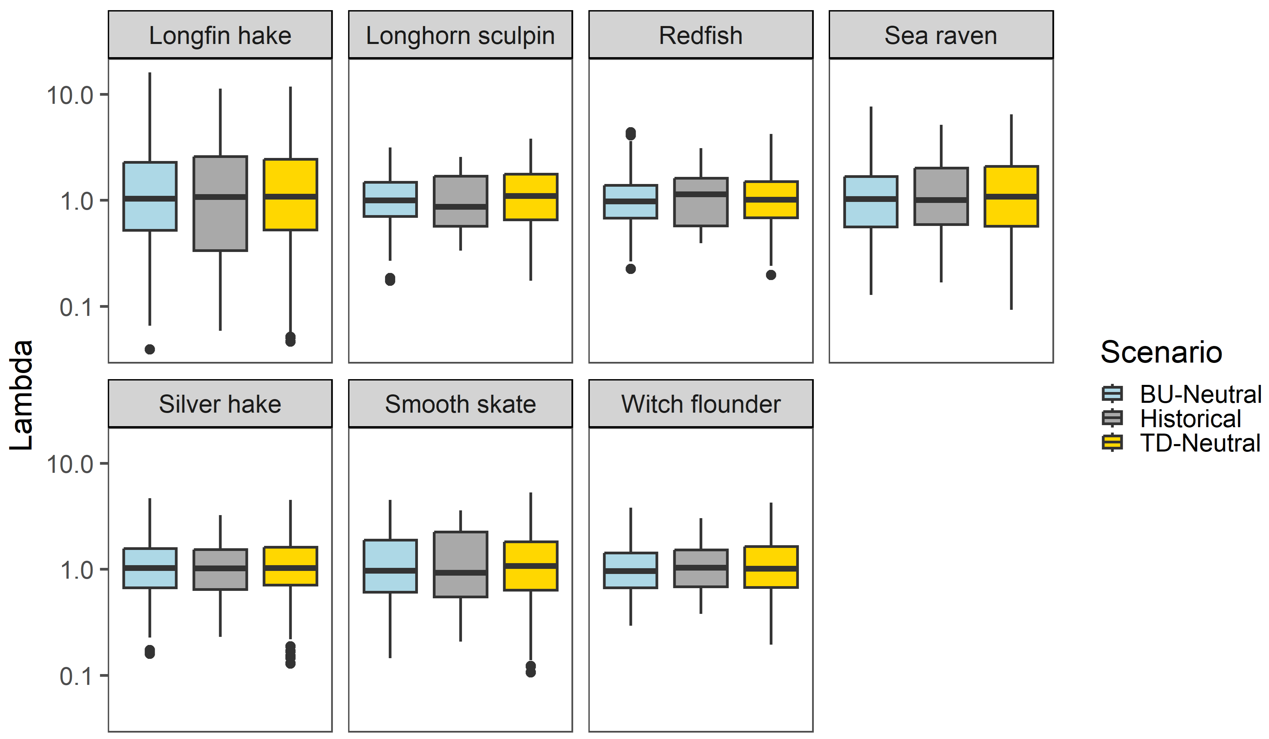
Larges
Mediums
Notes:
Frankenstein figures together – think I like this best, but with grey background line added in

Slide 10
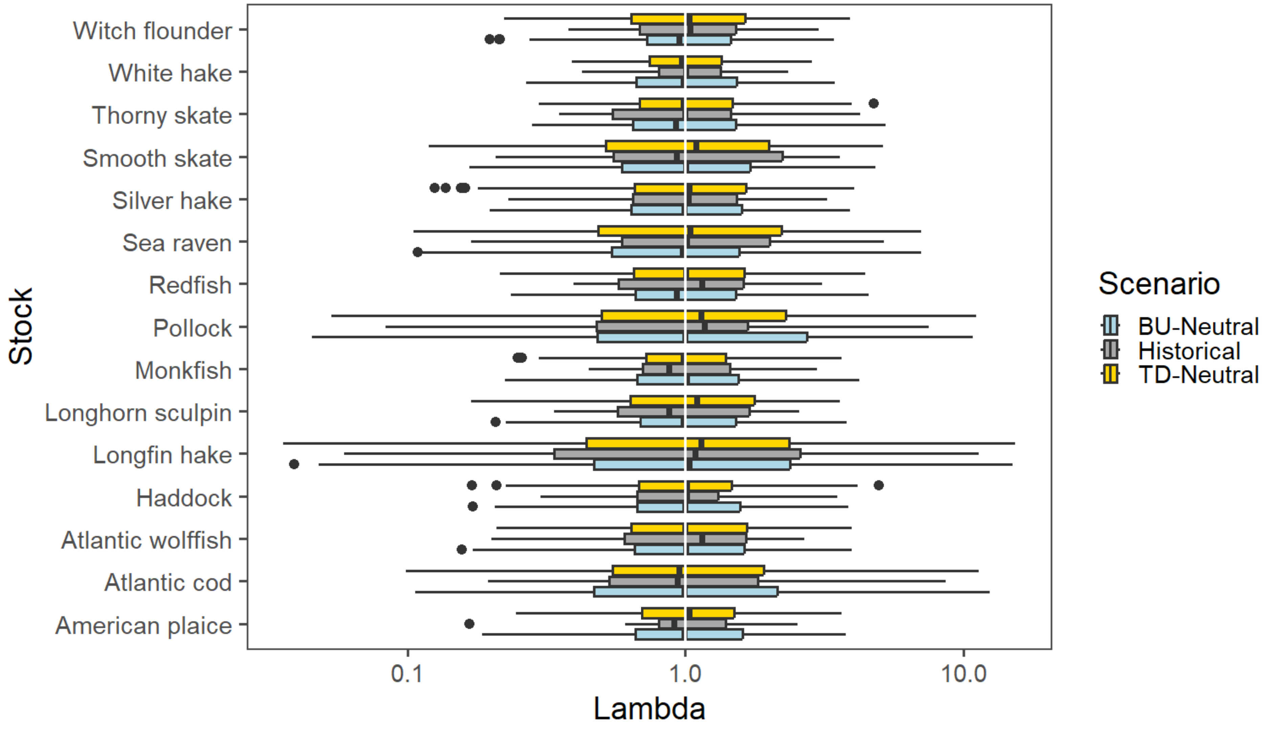
Notes:
Comparing distribution of historical and simulated lambdas for each stock. X-axis is log scale. White line is at lambda = 1

Slide 11
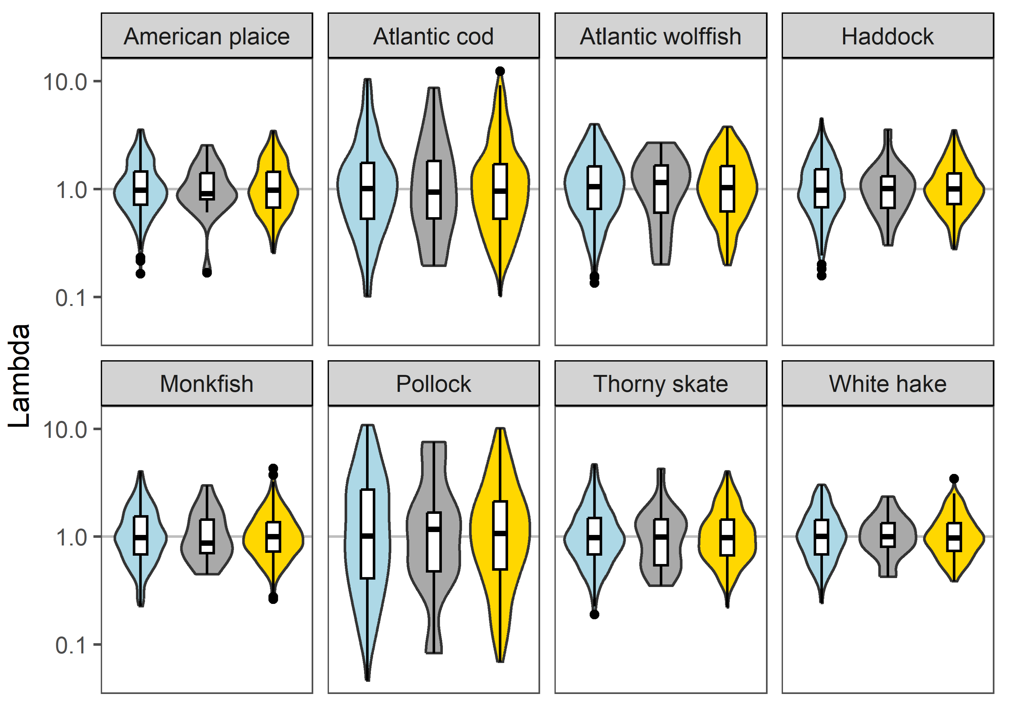
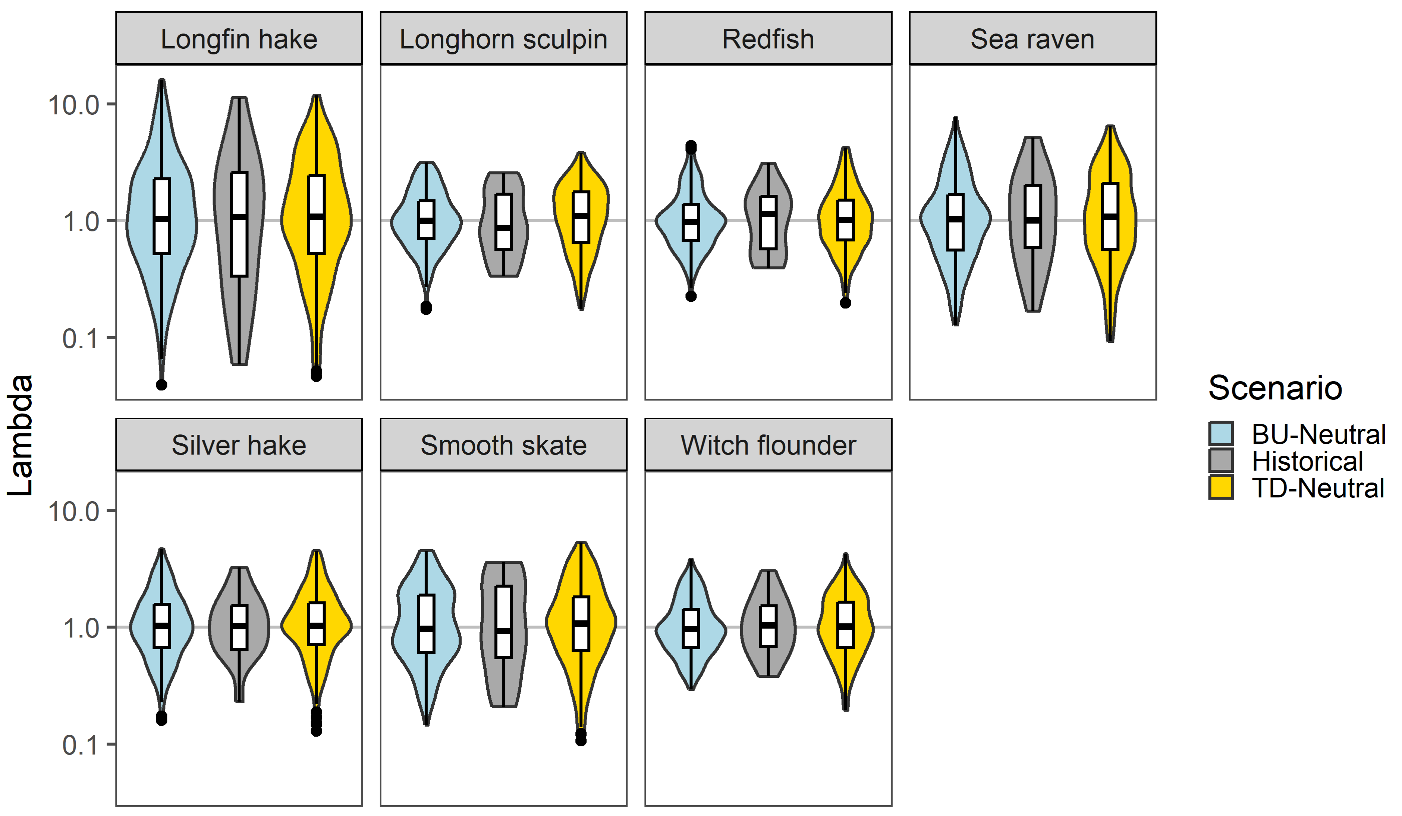
Notes:
Lambdas as violins?

Slide 12
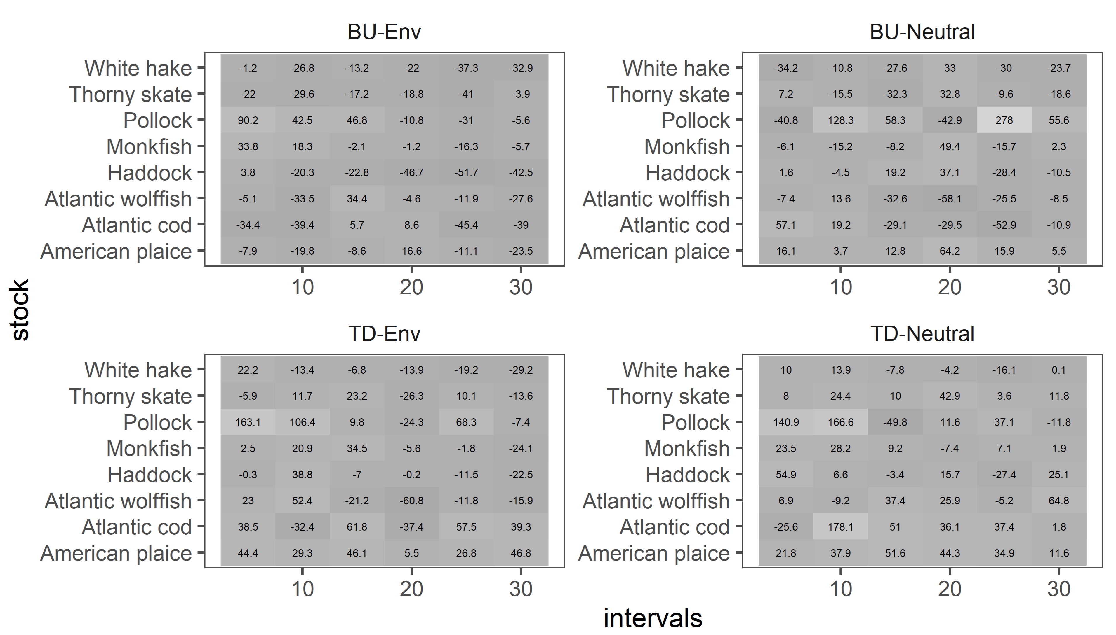
Notes:
Scaling issues here
Realizing that colour scale is tricky

Slide 13
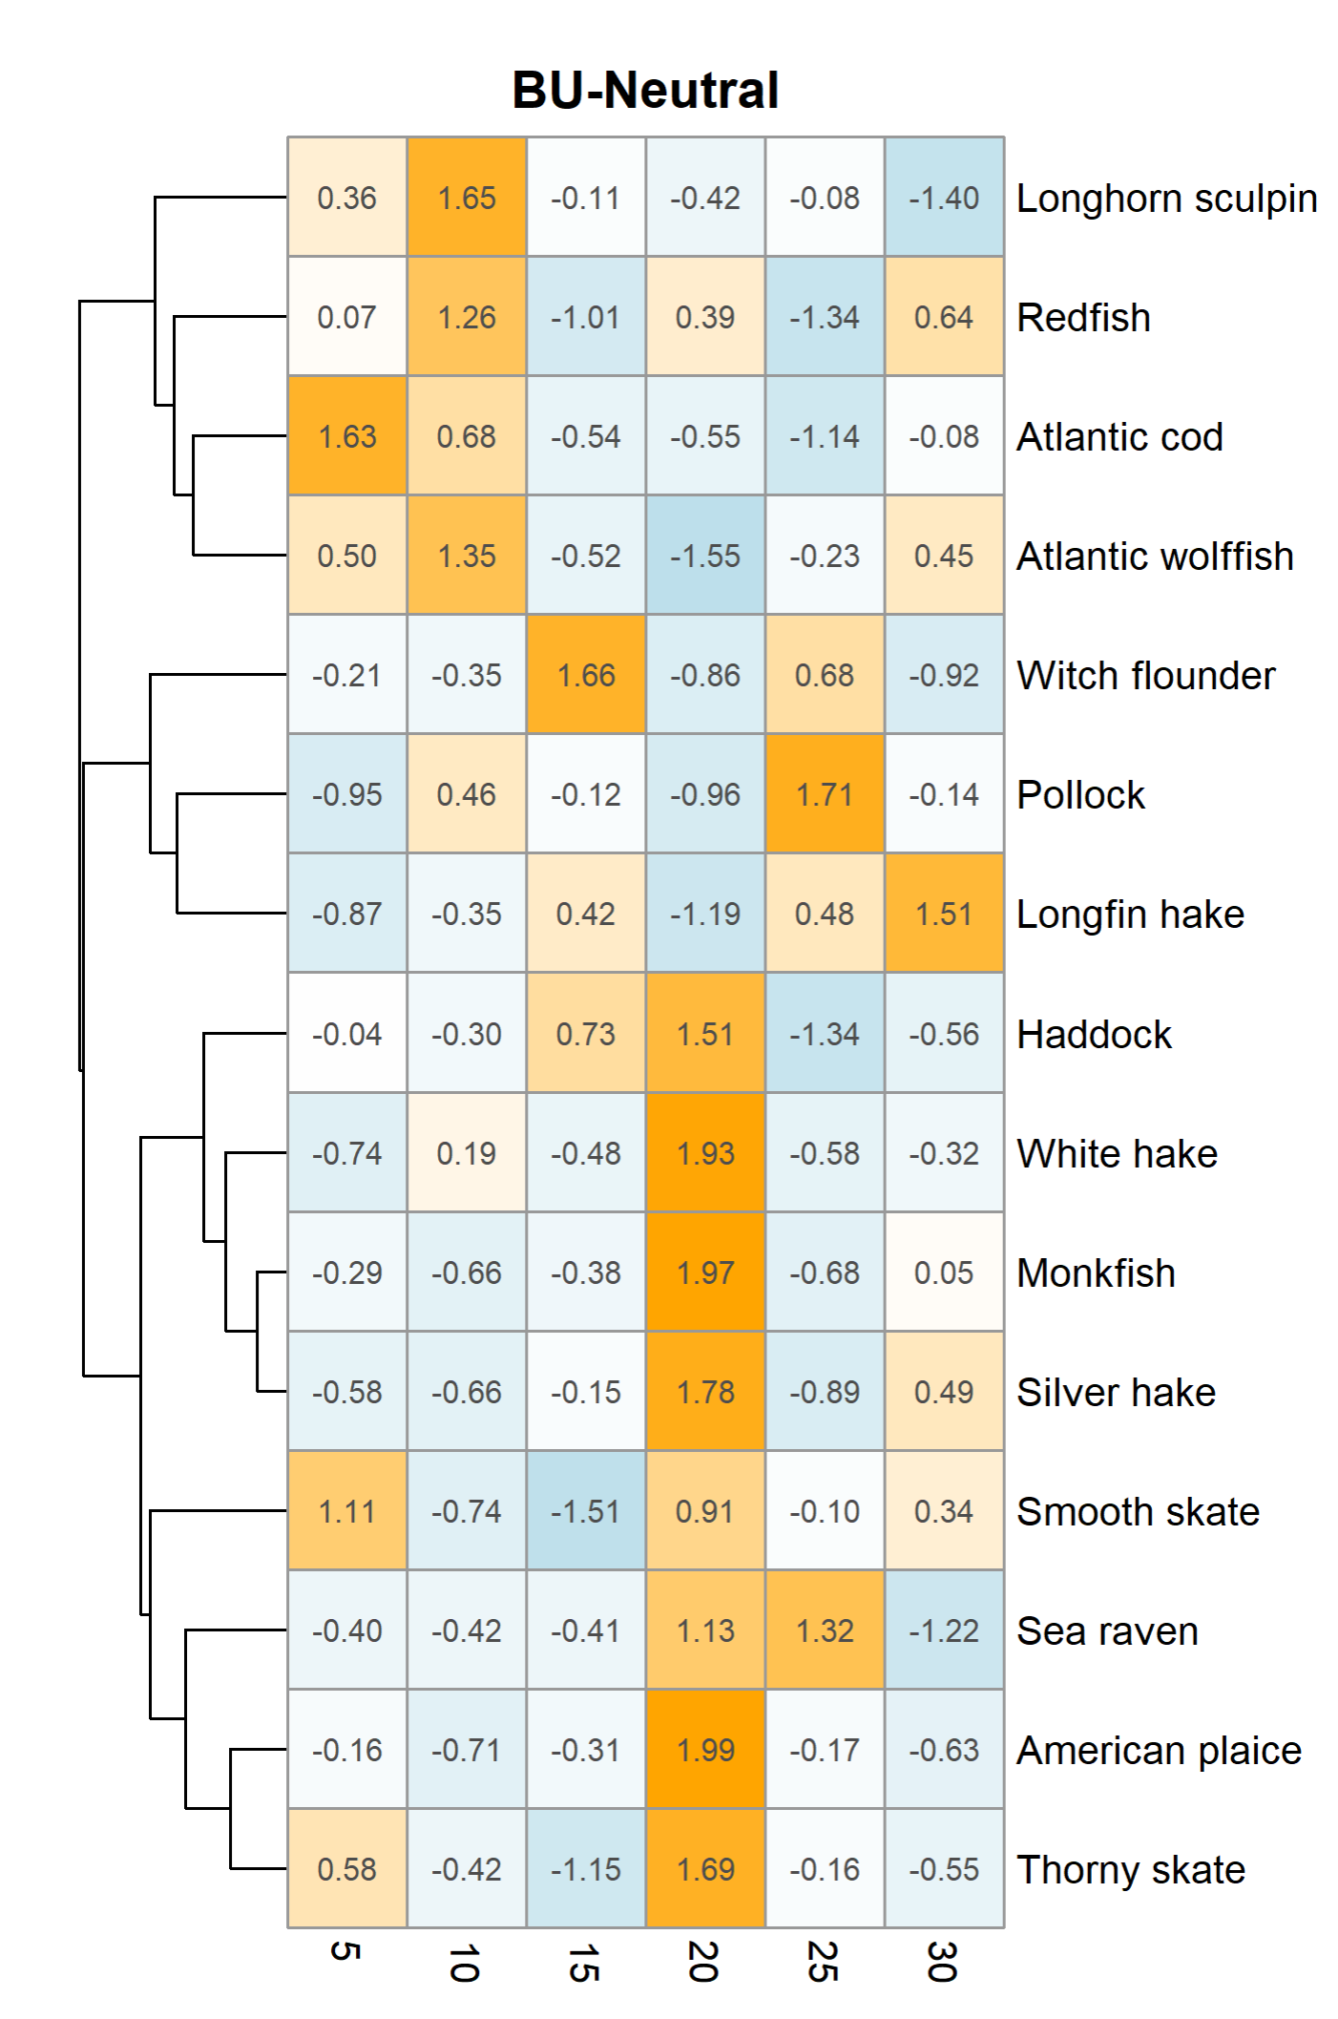
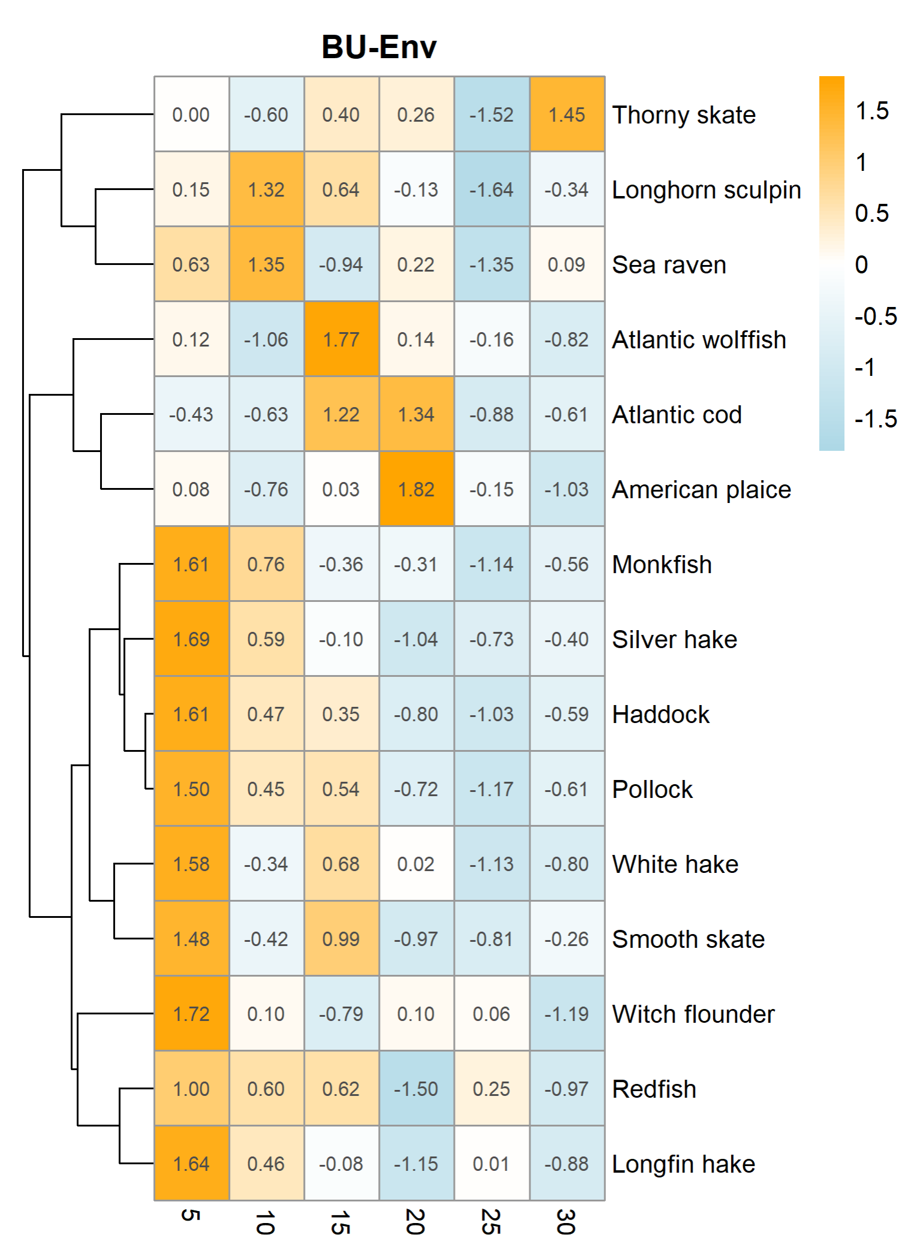
Notes:
Heatmap with cluster analysis – too much? Tried to scale using built-in pheatmap function but don’t fully understand how it works yet

Slide 14
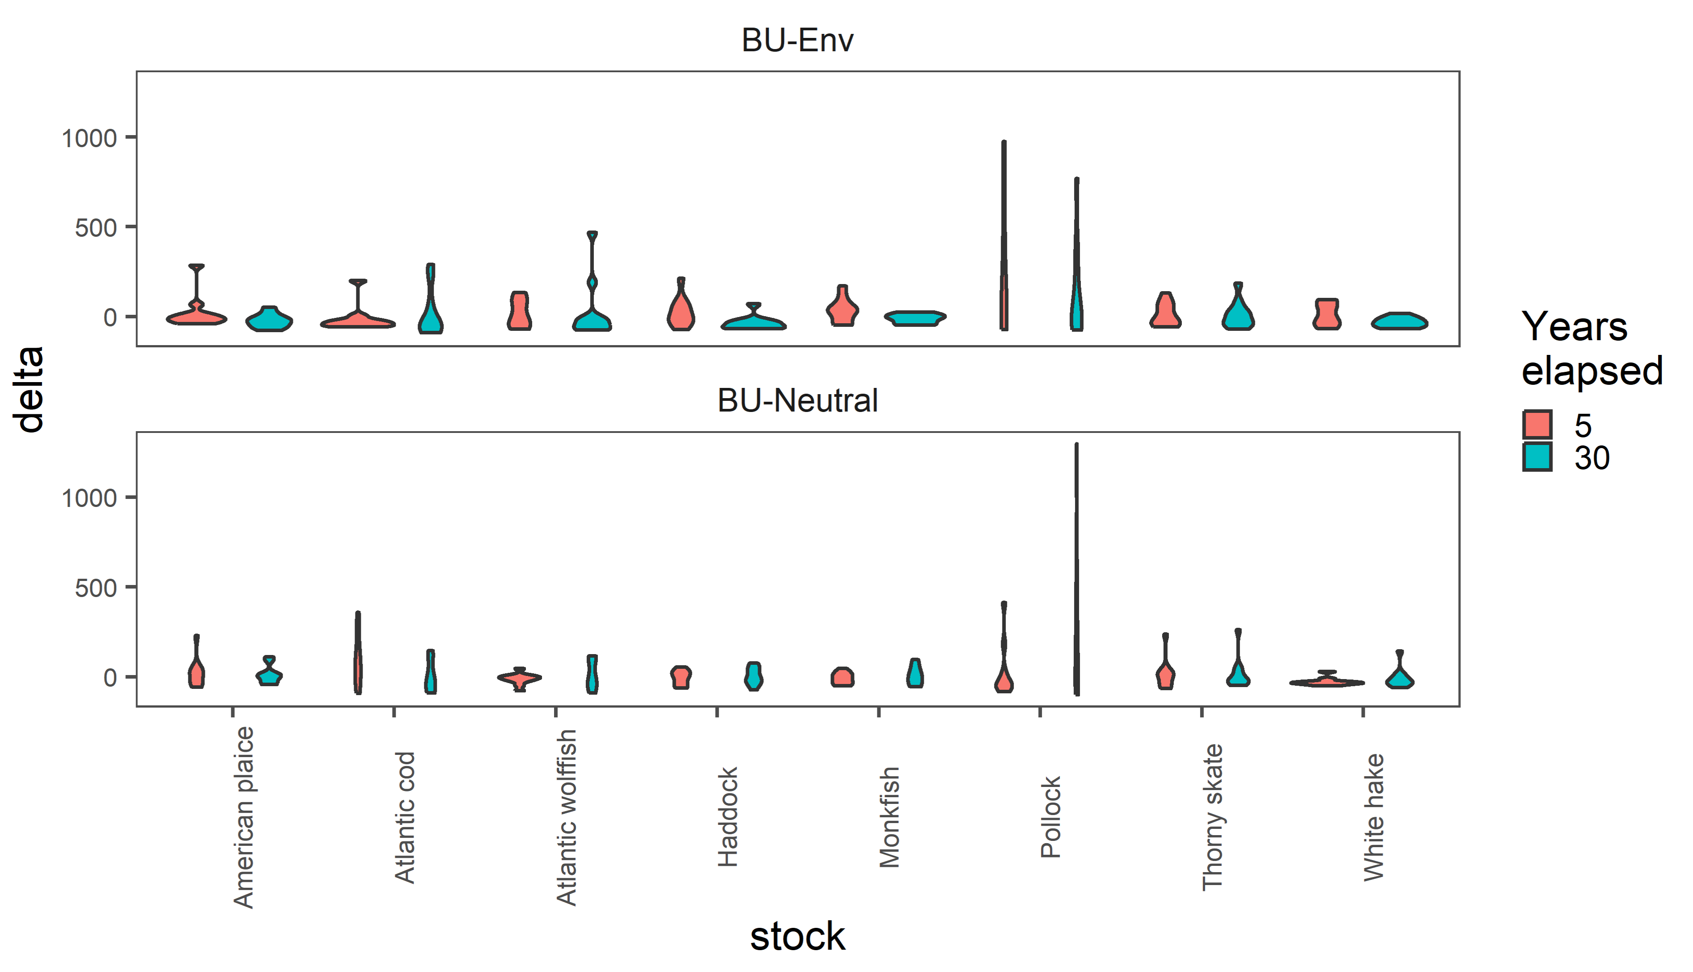
Notes:
Also tried violins for percent change – couldn’t get a good layout where everything was visible

